Slide 1
Right Care Initiative

Slide 2
Bottom Line Up Front
The Right Care Initiative is a state-wide effort to eliminate strokes, heart attacks, and diabetic complications by attacking the three modifiable risk factors of Diabetes, Hypertension, and Lipid control through the use of best practices.
By utilizing best practices to treat hypertension and diabetes, heart attacks and strokes can significantly be reduced in a relatively short time period of 2-3 years.

Slide 3
Best Practices Include
Engaging Providers and Patients
Implementing a treatment algorithm
Intensifying treatment rapidly
Implementing a care team which includes a Pharmacist and Certified Diabetic Educator
Continuously measuring success and publicly reporting

Slide 4
Why should I care?
It’s the right thing to do for your patients - You can reduce Major Adverse Cardiac Events in 1 in 6 of your high-risk patients (17%) in 2-3 years
Implementing the change is relatively easy and cost effective
You are probably not doing as well as you think you are….

Slide 5
INSERT Provider Organization Quality Results for HTN, DM, and Statin for CVD and DM here

Slide 6
Hypertension

Slide 7
How to Prevent One in Six of Your Hypertensive Patients from Dying from a Stroke or Heart Attack in 2 years!

Slide 8
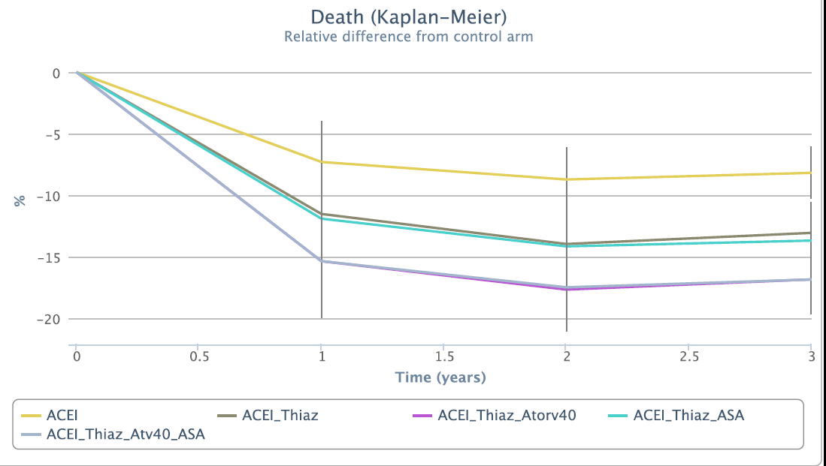
Decrease Deaths over 17% (1 in 6) in 2 years - Treat them NOW

Slide 9

Notes:
San Diego HTN med protocol
Adapted from Kaiser algorithm

Slide 10
Diabetes

Slide 11
ADA 2021 Guidelines
Summary available at
https://professional.diabetes.org/content-page/practice-guidelines-resources
Metformin still first line
GLP1 prior to insulin
Further refinement of choice of drugs for T2 D by comorbid conditions
Seems complex but can be broken down rather easily
Notes:
GLP -1 and SGLT2 with proven cardiovascular disease used in all categories except for low cost

Slide 12
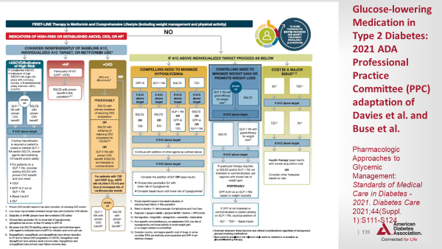
ASCVD SGLT2 or GLP1
HF SGLT2
CKD SGLT2 for albumin or GLP1
Decrease risk hypoglycemia
SGLT2
or GLP1
Weight Loss
SGLT2
or GLP1
Cost major factor
SU or TZD

Slide 13
CV Disease Risk Reduction

Slide 14
AHA/ACC Lipid Guidelines*
Emphasizes Provider – Patient discussion
Continue to support risk calculator use
https://clincalc.com/cardiology/ascvd/pooledcohort.aspx
Role of Coronary Artery Calcium score in some populations
Role of PCSK9, and need for cost / benefit discussion
*
Grundy SM, et al. 2018 Cholesterol Clinical Practice Guidelines
2018 AHA/ACC/AACVPR/AAPA/ABC/ACPM/ADA/AGS/APhA/ASPC/NLA/PCNA Guideline on the Management of Blood Cholesterol
A Report of the American College of Cardiology/American Heart Association Task Force on Clinical Practice Guidelines

Slide 15
CVD risk – do they need a statin?
CVD or DM should be on a statin.
Others: Measure CVD risk using pooled cohort equation
https://clincalc.com/cardiology/ascvd/pooledcohort.aspx
If patient has > 7.5 % CVD risk:
“ALL” treatment from Kaiser
  Aspirin (>10% CVD risk and age 50-59; level B rec)
  Lisinopril
  Lipitor

Slide 16
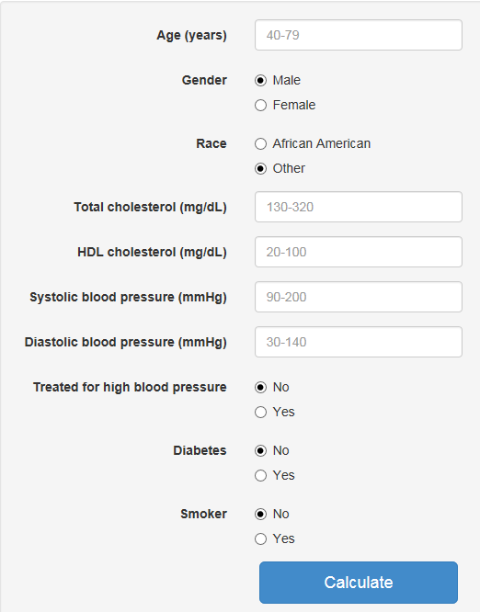
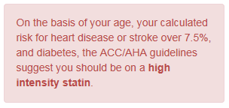
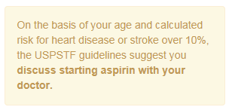
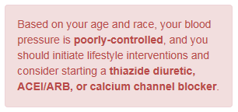
Calculating Cardiovascular Risk
www.cvriskcalculator.com/

Slide 17
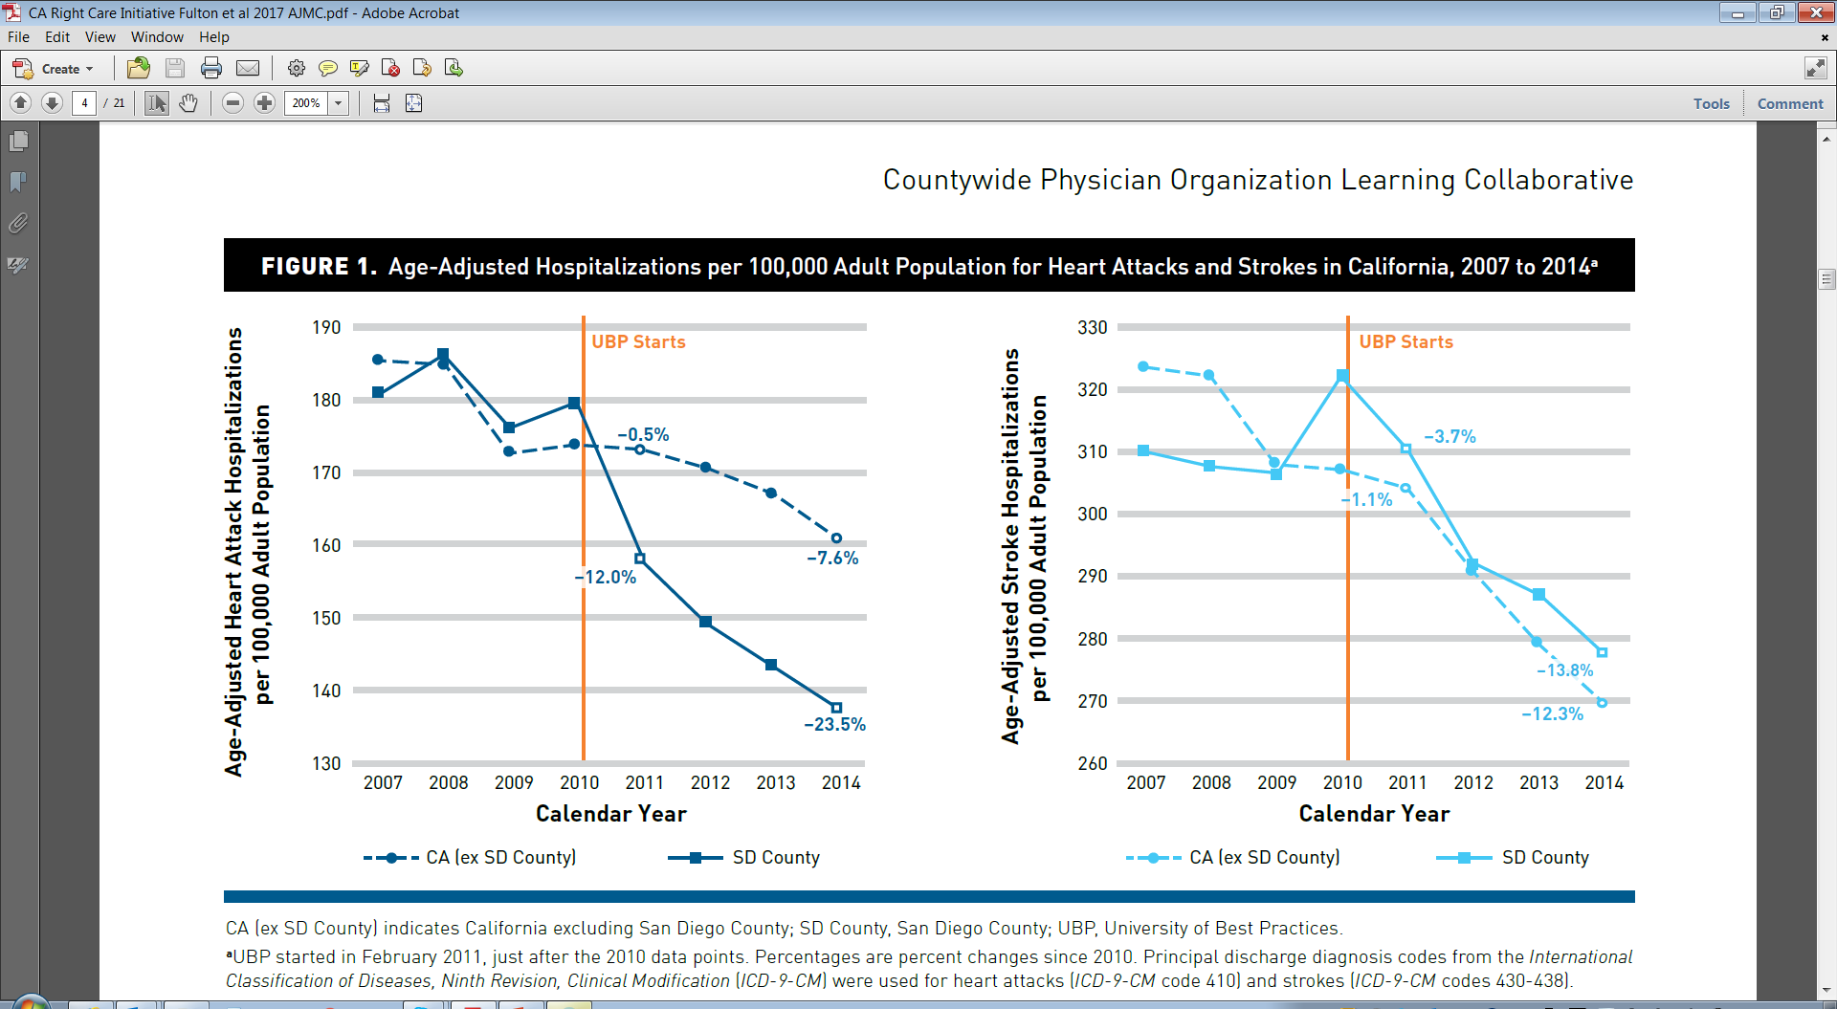
Does it Work?
Experience in San Diego
Countywide Physician Organization Learning Collaborative and Changes in Hospitalization Rates
Brent D. Fulton, PhD, MBA; et al.
Am J Manag Care. 2017;23(10):596-603

Slide 18
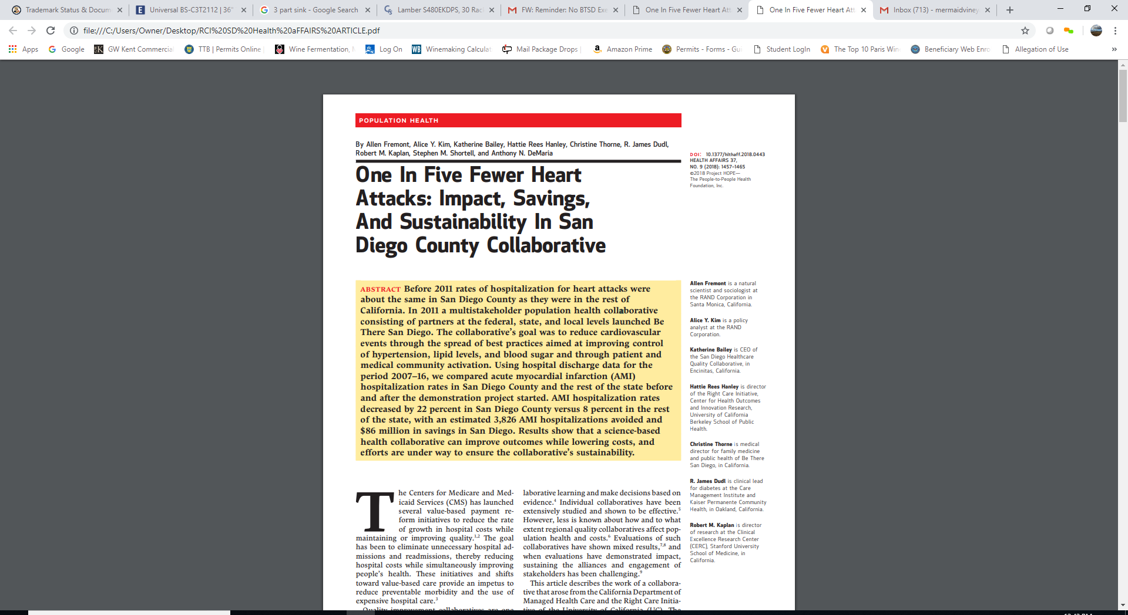
HEALTH AFFAIRS 37,
NO. 9 (2018): 1457–1465

Slide 19
Next Step -Provider Self Evaluation Tool
Develop action plan based on results
 | BSC HTN Best Practices Worklist | Group Name:
 |  | Date Evaluation Completed:
 | Hypertension "Best Practices" Worklist Item | Group's Status | Notes | Resource | Action Item
Leadership | Multidisciplinary team that includes clinical champion(s) |  | Should include Clinical Champions | Best Practice: Zufall Health "Building a Team"
 | Engaged all providers and clinical staff through education |  | Engage Providers and direct support staff in importance of controlling BP - can reduce strokes and heart attacks in high risk individuals 17% in two years. Synergy with Million Hearts, AMGF Measure up Pressure Down, AHA and AMA Target: BP | RCI Template Presentation
 | Internal public reporting of HTN control by provider |  | Peer Collaboration
 | Recognition of providers with excellent performance |  | public recognition, financial incentives through quality program
Processes | Process map of clinic visit flow to evaluate delivery of care pre-visit, visit and post-visit
 | Hypertension is addressed at every primary care visit |  | Sample Chart Audit
 | Consistent Process to ensure HTN measurement part of every visit |  | Ensure every visit includes a BP reading; include specialty, and a process for routing back to primary care when reading is elevated >140/90
 | Staff trained to take accurate BP |  | Guidelines on patient posture, wait time, caffeine and smoking; retest all BP >140/90 after 5 minute rest. Co-assess with staff and providers Initial and annual refresher. Sign at eye level from patient instructions, such as uncrossing feet | AMGF measure up pressure down
 | BP rechecks done on all patients not in BP control prior to leaving office, and documented in chart |  |  | 7 Simple steps to ensure ACCURATE reading
 | Point of Care reminders in EHR
 | Adopt Hypertension Algorithm |  |  | Template from SD RCI
 | Intensify treatment every 2-4 weeks until goal reached |  | No co-pay return visit with MA / RN to repeat BP
 | Monitor use of Algorithm |  | Pharmacy statistics: Number of medications per patient Chart Review
 | Patient registry for Hypertension |  |  | AMGA Best Practice in HTN Registry
 | Medical group participates in programs to improve HTN medication adherence |  | Leverage pharmacists/ pharmacy techs to improve adherence | Case Study for use of Pharmacist on team
 | Medical group reviews drug gap reports identifying members needing beta-blocker therapy after MI
 | Collaborative Practice Agreement with Pharmacist |  |  | Pharmacist help through Collaborative Practice Agreements greatly facilitates outcome | Template available
 | Adopted Standing Orders |  |  | UCSF Example: Center for Excellence in Primary Care
 | Specialists refer high BP to PCP |  | sample chart audit

Slide 20
Care worthy of our friends and family

